Slide 1
“CVRCE INTRA HACKATHON”
Idea Implementation Outlook
By Team “ZEROBUG”

Slide 3
Problem Statement(User Case):
Alternative for Captcha Authentication for visually impaired people

Slide 4
Basic Idea:
We use technology stacks such as Javascript, Python, Tesseract (for conversion platform) and Wordpress for modifying the Captcha image into a form which can be sensed by a visually impaired person.
And this form implied here is the vibration capability of a human being.

Slide 5
Basic Flow:
Firstly we create a website with the url as “parivartan.ga” which acts as the interface b/w the visually impaired user(actor) and the administrator controlling that website. A snapshot of the website is provided in the adjoining slide.
This website is a sample for providing alternative option at the login portal if the visiting user is visually impaired.

Slide 6
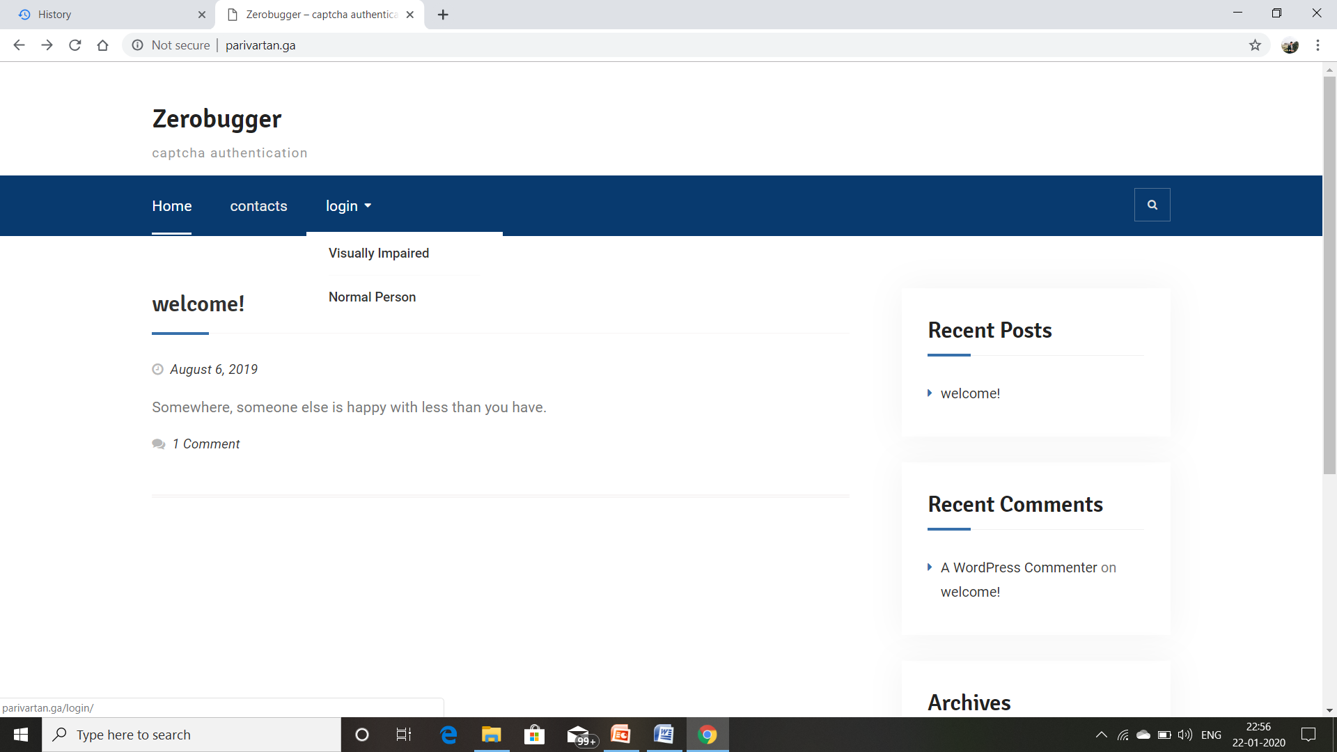
Snapshot of the website:

Slide 7
OCR Technique implementation:
Presently, we may use PyTesseract which is a python wrapper that helps us to imply the Tesseract-OCR engine to convert images to the accepted format from Python code.
But as this method is not 100% workable for captchas with large amount of noise in the background, hence for the fullproof solution we shall create an algorithm which will reduce the background noise to improve the accuracy of this image to text conversion.

Slide 8
Text to morse code conversion:
In the next stage we ask the user to connect his/her pc or whatever device he/she is working on with the application which is needed to be downloaded on a device with vibration functionality(such as mobile phone)
Next we run a javascript code using the “morse.js” library in the back end of the website which converts the OCR modified image in the text form into the morse code form.

Slide 9
Morse Code Pattern used:
This morse pattern is implemented in the code using a set of short (dot) and longer (dash) signals. The best known one is SOS, which encodes to "··· --- ···".
We seperate each letter using an empty space (" ") character and seperate each word with the pipe ("|") character.
This morse code encoded message can be sent to the receiver in the form of datagrams or through creating a websocket.

Slide 10
Application to be installed:
Next, we create an application which is installed on the morse code receiver.
This application contains the javascript code with the “navigator.vibrate()” function to take the morse code as input and produce the vibration as output by passing a particular set of values into the function for a specific morse code pattern.

Slide 11
The final sense:
This vibration pattern is sensed by the visually impaired person and the corresponding captcha is submitted by the user on the website as authentication.

